Slide 1

Human Computer Interaction
User Support
Imran Siddiqi
imran.siddiqi@gmail.com

Slide 2
User Support
Types of user support
  Quick reference
  Task specific help
  Full explanation
  Tutorial
User Support

Slide 3
User Support
Provided by help systems and documentation
  Help Systems - problem-oriented and specific
  Documentation - system-oriented and general
  Same design principles apply to both
User Support

Slide 4
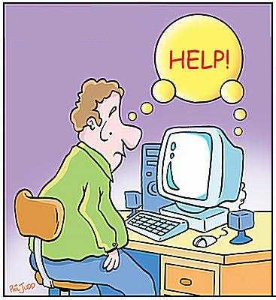
Requirements
Availability
  User able to access help any time during interaction with the system
Accuracy and completeness
  Help matches and covers actual system behaviour
  Should cover the whole system
Consistency
  Between different parts of the help system and paper documentation
User Support

Slide 5

Requirements (Contd…)
Robustness
  Help System – People in difficulty, System failure
  Correct error handling
Flexibility
  Allows user to interact in a way appropriate to experience and task
  Hyperlinks
Unobtrusiveness
  Does not prevent the user continuing with work
User Support

Slide 6
Approaches to User Support
Command assistance
  User requests help on particular command
  help java, help copy etc.
  Good for quick reference
  Simple and Efficient
  Assumes user know what to look for
  Cannot cover the commands user does not know
User Support

Slide 7
Approaches to User Support
Command prompts
  Provide information about correct usage when an error occurs
  Good for simple syntactic errors
  Also assumes knowledge of the command
User Support

Slide 8
Approaches to User Support
Context sensitive help
  Help request interpreted according to context in which it occurs
  Examples
    Tool-Tips, MS Office What’s this?, Web page roll-overs etc.
User Support

Slide 9
Approaches to User Support
On-line tutorials
  User works through basics of application in a test environment
  Can be useful but are often in flexible
  Not intelligent – No information about user and his experiences
  May fail to recognize correct answers simply because it is not in the expected format
User Support

Slide 10
Approaches to User Support
On-line documentation
  Paper documentation is made available on computer
  System Manual – Paper or Computer
    Reading Text on paper is preferred
    Constrained to one physical location
    Online manual – Available to large number of users concurrently
    Search capabilities
    Hypertext used to support browsing
User Support

Slide 11

Approaches to User Support
Wizards
  Task specific tool leads the user through task, step by step, using user’s answers to specific questions
  Example: resumé
  Useful for safe completion of complex or infrequent tasks
  Constrained task execution so limited flexibility
  A good designed wizard:
    Must allow user to go back and forward
    Must have a progress indicator
User Support

Slide 12
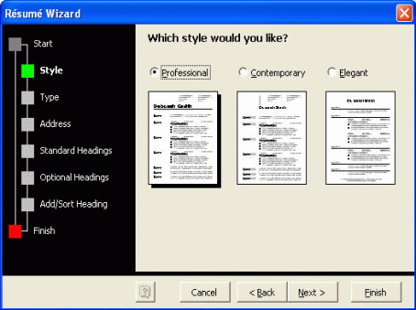
Approaches to User Support
Resume Wizard
User Support

Slide 13
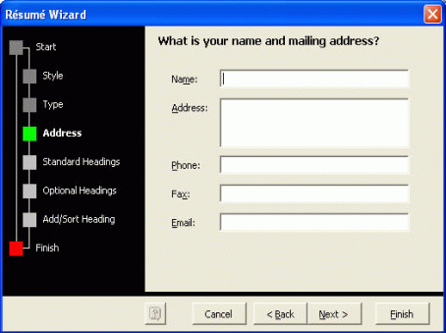
Approaches to User Support
Resume Wizard
User Support

Slide 14
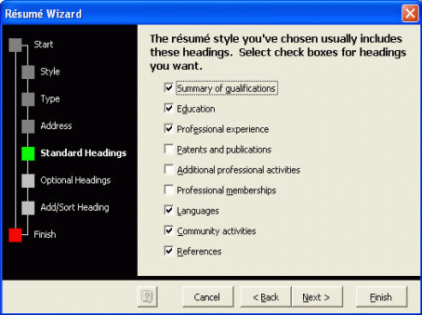
Approaches to User Support
Resume Wizard
User Support

Slide 15
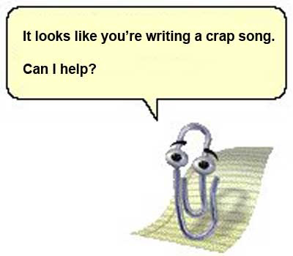
Approaches to User Support
Assistants
  Monitor user behaviour and offer contextual advice
  Can be irritating e.g. MS paperclip
User Support

Slide 16
Designing User Support
User support is not an `add on’
  Should be designed integrally with the system
User Support

Slide 17
Presentation Issues
How is help requested?
  Command, button, Menu …
How is help displayed?
  New window, whole screen, split screen, pop-up boxes, hint icons
Effective presentation requires
  Clear, familiar, consistent language
  Instructional rather than descriptive language
  Avoidance of blocks of text
  Clear indication of summary and example information
User Support

Slide 18
Implementation Issues
Structure of help data
  Single file
  File hierarchy
  Database
What resources are available?
  Screen space
  Memory capacity
  Speed
User Support

Slide 19

References
Chapter 11 - Human Computer Interaction by Dix et al.
Dialog Notations and Design

